Slide 1

Surfaces, Interfaces & Beyond
UW- Madison Geoscience 777
ELECTRON SPECTROSCOPIES FOR SURFACE ANALYSIS:
X-ray Photoelectron Spectroscopy
Auger Electron Spectroscopy
Peter Sobol
Department of Geoscience
University of Wisconsin - Madison
March 12, 2019

Slide 2
What’s the point?
UW- Madison Geoscience 777
With SEMs and electron microprobes we image materials and determine chemistry using electrons to produce secondary and backscattered electrons and X-rays – giving us certain information – based upon the “interaction volumes”of 10-20 keV electrons
There are other valuable related techniques, with some similarities, also using electrons and X-rays, which give additional information, typically of much shallower regions of sample: surface techniques:

Slide 3
4 Analytical techniques traditionally classified as “Surface” techniques
UW- Madison Geoscience 777
X-ray Photo-electron Spectroscopy (XPS) –
Excitation: “Monochromatic” Soft X-rays (<1.4keV)
Analyzed species: Inelastic “photo”-electron electrons
Auger Electron Spectroscopy (AES) –
Excitation: High energy electrons (3-15keV)
Analyzed species: Inelastic “Auger” secondary electrons
Secondary Ion Mass Spectrometry (SIMS)–
Excitation: High energy ions (5-10keV)
Analyzed species: Secondary ions.
Low Energy Ion Scattering(LEIS,ISS)
Excitation: low energy ions <500eV
Analyzed species: Scattered primary ions

Slide 4
“Surface Analysis” Definitions
UW- Madison Geoscience 777
Sensitive to the volume of a material adjacent to an interface where the properties (structure, composition, chemistry) are influenced by the presence of the interface, as opposed to the bulk.
Typically the outer (1-20) atomic layers: depths of 0-100 angstroms. Sub mono-layer sensitivity.
Why is this important?
Most interactions between materials are determined by the surface properties, not the bulk properties of the material
“Bulk” material properties are often a function of internal interface properties.

Slide 5
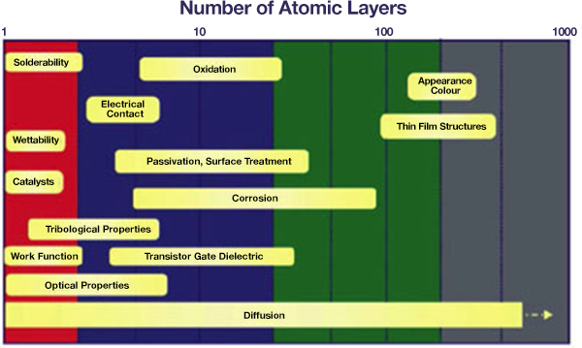
Interfaces and material properties:
UW- Madison Geoscience 777

Slide 6
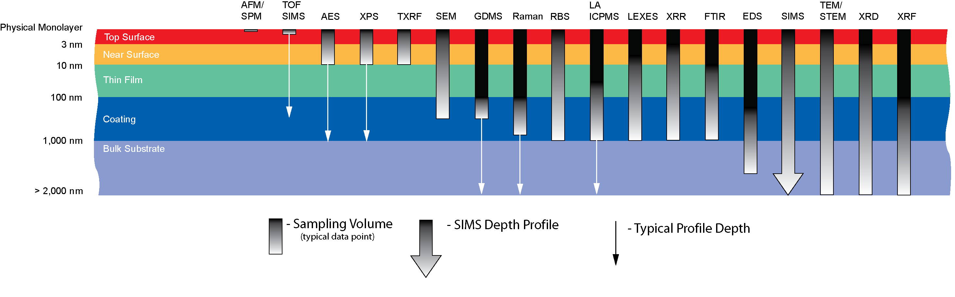
Surface Sensitive Techniques
Depth of Analysis
Courtesy of EAG Laboratories
UW- Madison Geoscience 777

Slide 7
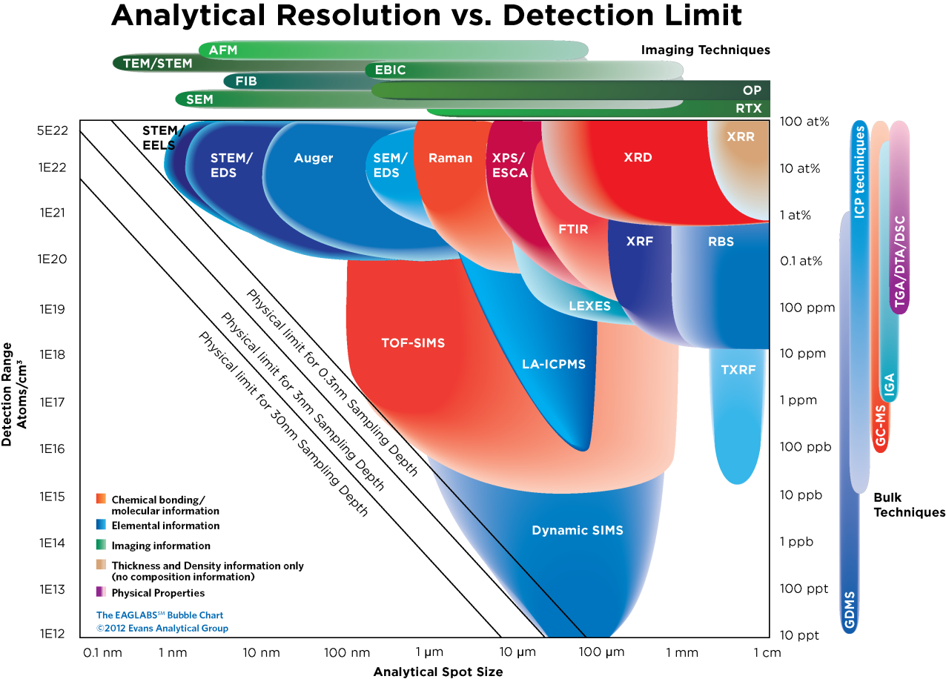
Surface Sensitive Techniques
UW- Madison Geoscience 777
Courtesy of EAG Laboratories

Slide 8
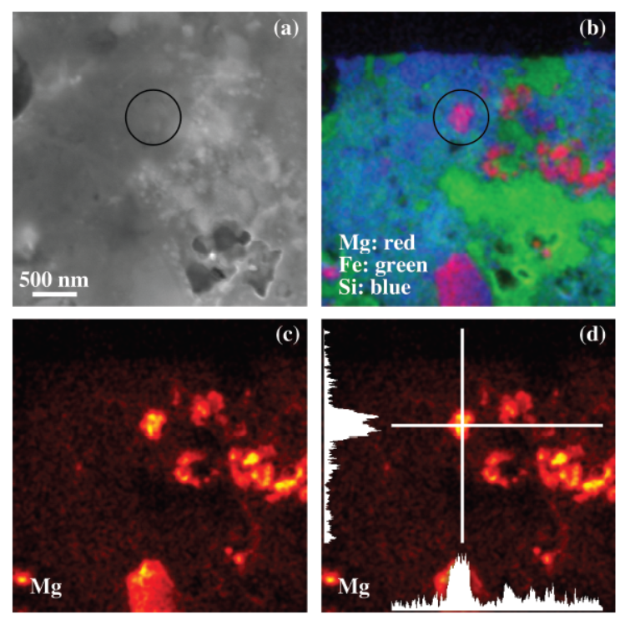
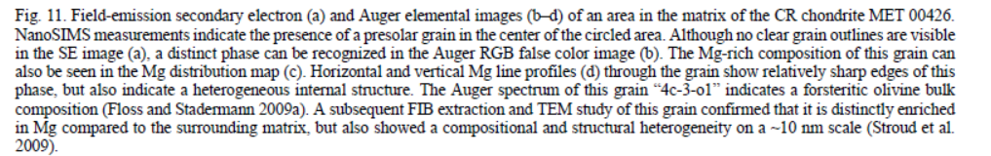
AES application: Pre-solar grains
UW- Madison Geoscience 777
Just one example showing what is possible:
SEM and Auger maps elemental maps
Pseudo-color overlay (upper right) identifies unique material phases
Magenta phase is identified as a forsteritic olivine (fosterite) phase ~300nm in size.
Smaller grains of similar composition are visible in the image.
https://journals.uair.arizona.edu/index.php/maps/article/viewFile/15752/15740

Slide 9
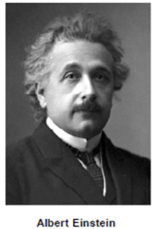
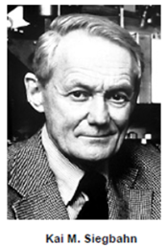
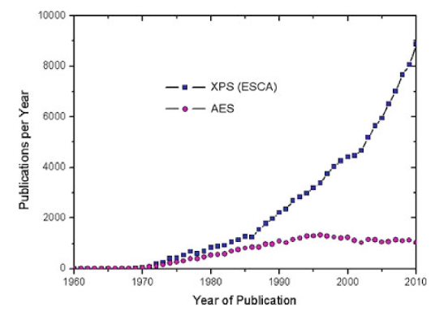
A little History
XPS:
1887 Heinrich Hertz observes metals illuminated with UV light emit electrons- but with a low frequency cutoff, regardless of intensity
1905 Einstein explanation: light is quantized (photons) each with energy hʋ. important step in development of quantum theory – (Nobel prize)
1954- Kai Siegbhan at University of Uppsula, Sweden develops technique and instrumentation. 1967 publishes reference book: “Electron Spectroscopy for Chemical Analysis”: ESCA – (Nobel prize)
AES
Auger process discovered in 1923 by Lise Meitner and independently in 1925 by Pierre Auger
1953 Lander proposes using Auger electrons for analysis
1960’s Laboratory instruments. ~1970 first commercial instruments (Physical Electronics, Inc., Eden Prairie MN).
UW- Madison Geoscience 777

Slide 10
Comparison of Surface Analysis Techniques
AES XPS SIMS EDS/WDS
Probe Beam Electrons X-rays Ions Electrons
Analysis Beam Electrons Electrons Ions X-rays
Spatial Resolution 0.008 µm 10 µm (1mm) 0.07 µm 0.5-3 µm
Sampling Depth(nm) 1-10 1-10 1-2 300-3,000
Detection Limits 0.1atom % 0.01atom % ppm 0.1 atomic%
Information Content Elemental Elemental Elemental Elemental
Chemical Chemical Molecular
Quantification Fair Excellent Std. needed Good
UW- Madison Geoscience 777

Slide 11
But: Surface Analytical techniques are frequently extended and/or extrapolated in order to characterize bulk material properties!
UW- Madison Geoscience 777

Slide 12
X-ray Photoelectron Process
UW- Madison Geoscience 777
Photoelectron
X-ray
E_{vacuum level}
E_{fermi level}
_{3/2}
2p
_{1/2}
Binding Energy
2s
1s
Binding Energy = X-ray Energy (hν) - Photoelectron Kinetic Energy

Slide 13
XPS: Photon-electron interactions:
UW- Madison Geoscience 777
Photon interactions with charged particles are “all or nothing”: a photon normally gives up all its energy or doesn’t interact at all (required to satisfy both conservation of momentum and energy!)
Photoelectron Kinetic Energy = hν – Binding Energy*
Photons may interact with any electron where E(photon) > Binding Energy.
All elements have at least one electron orbital with binding energy <1.1KeV
* there’s always an asterix!

Slide 14
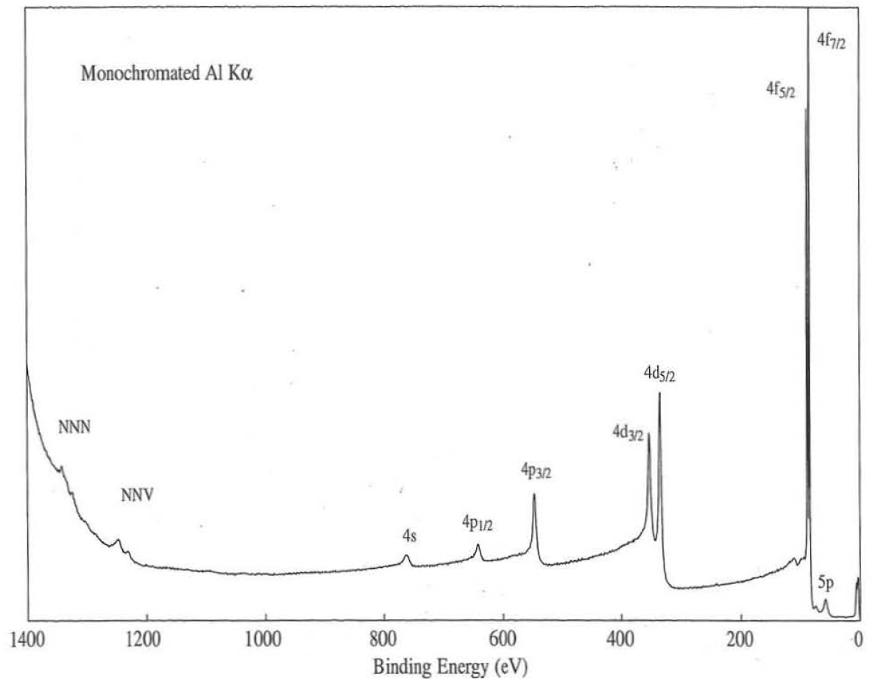
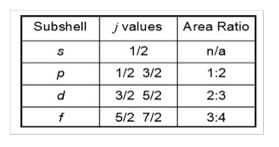

XPS: Au Survey spectrum
UW- Madison Geoscience 777
All occupied orbitals with E<hv (photon energy) will produce photoelectrons.
Area ratios between different orbital peaks will be consistent (aid to identification)
Orbitals with angular moment l > 0 (everything but s orbitals) exhibit “Spin-orbit” splitting into 2 lines with fixed ratios.
$j=l±s$
$j=total angular momentum$
$l=orbital angular momentum=0,1,2,$…
$s=spin angular momentum= +\frac{1}{2}, −\frac{1}{2}$
Valence Band

Slide 15
Auger Electron Process
UW- Madison Geoscience 777
Starts with a vacancy in a core orbital
Process involves 3 electrons (usually denoted in spectroscopic notation)
Auger Electron Kinetic Energy:
E_{KLL} = BE_{K} – BE_{L} – BE_{L}
(binding energy for orbitals in the presence of core hole, not ground state of atom!)
Independent of origin of core hole!
Auger Electron
E_{vacuum level}
Kinetic Energy
E_{fermi level}
_{3/2}
L_{III}
2p
_{1/2}
L_{II}
Binding Energy
2s
L_{I}
1s
K
Core Vacancy (created X-ray, electron, or ion)

Slide 16
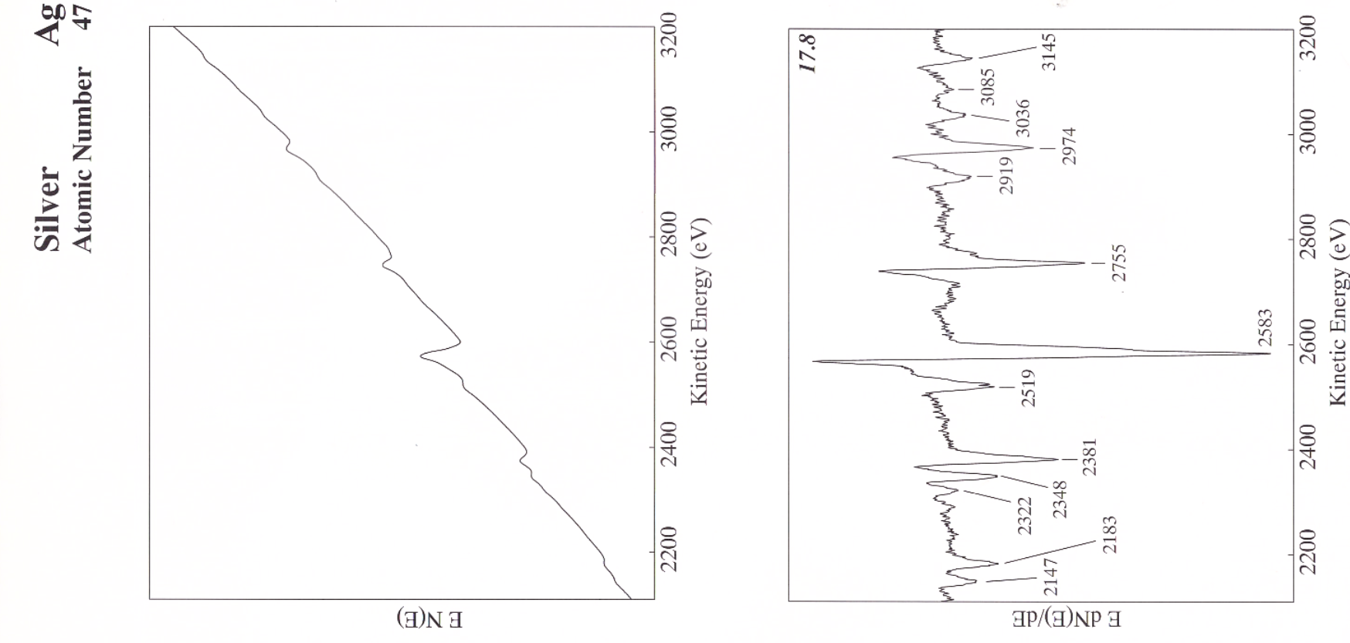
Auger: Displaying data
UW- Madison Geoscience 777
Auger lines typical consist of broad peaks on a large curved secondary background: E N(E)
→ Commonly displayed as differentiated data: E dN(E)/dE
Peak positions are usually listed as the position of the negative going peak in the differentiated data.
Because there are 3 electrons involved in the transition – and many possible combinations, spectra can have many peaks, especially for heavier elements .
EdN(E)/dE
E N(E) x 5
Cu MNN
Cu LMM
E N(E)
0
500
1000
1500
2000
2500
3000
Kinetic Energy (eV)

Slide 17
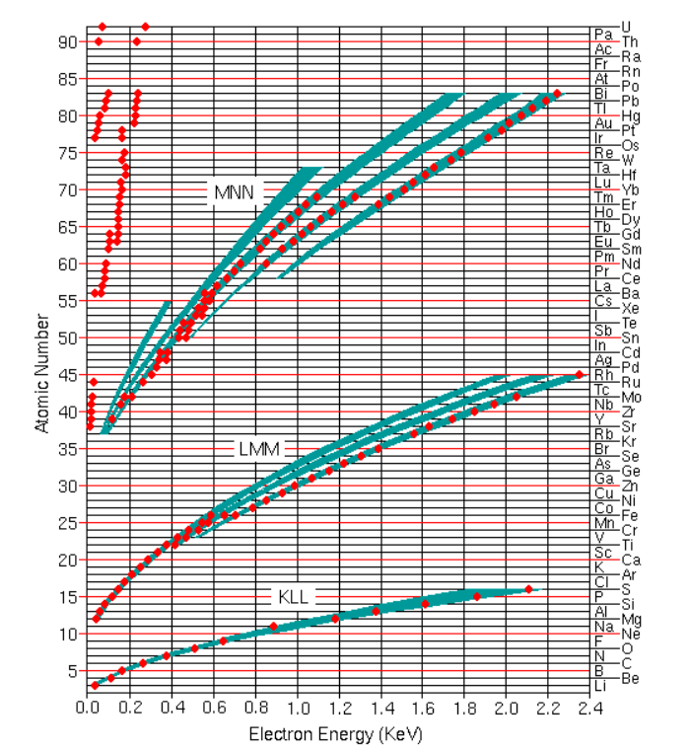
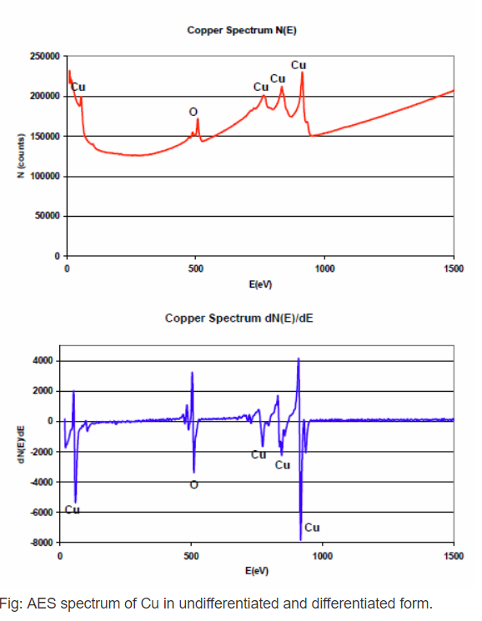
Auger: Spectra
UW- Madison Geoscience 777
Cu MNN Line ~60eV
Cu LMM series from 700-900eV
All elements have major lines <2keV

Slide 18
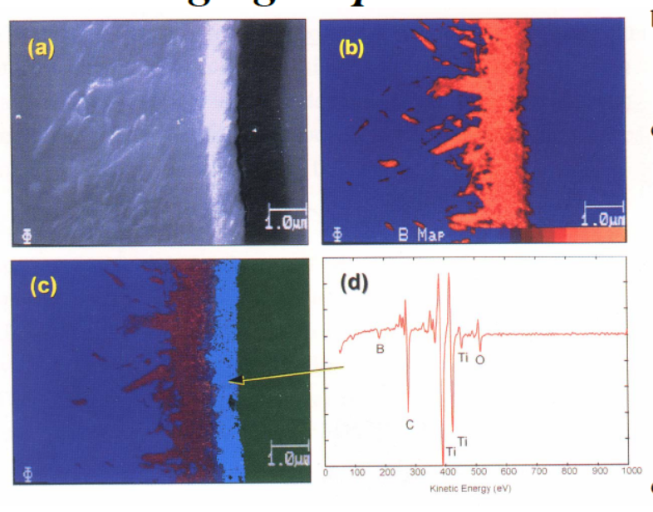
Auger: Spectra and images
Auger is inherently an imaging technique performed with an electron beam similar to EPMA
By plotting peak intensity vs. position we can create elemental and chemical maps of a surface.
.
UW- Madison Geoscience 777

Slide 19
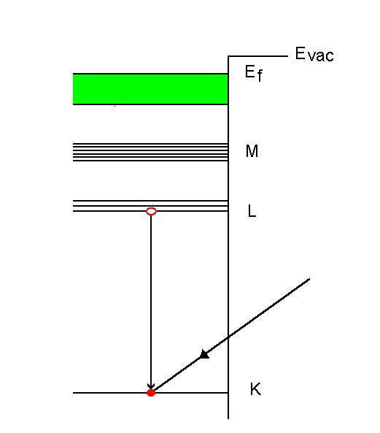
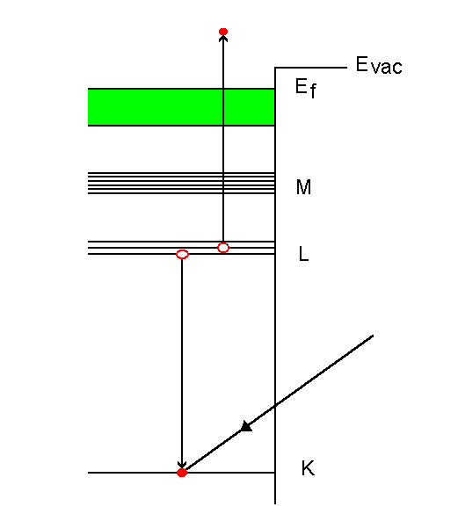
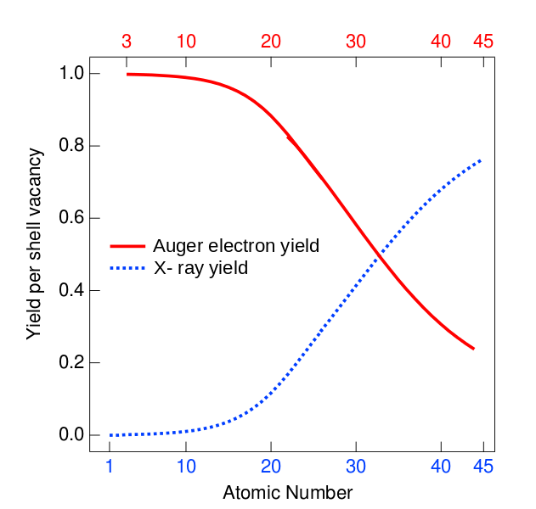

Auger Electron vs. X-ray Emission
UW- Madison Geoscience 777
X-ray Fluorescence
(detected in EDS/WDS)
X-ray fluorescence and Auger Electron emission are competing relaxation processes of a core electronic vacancies.
Auger Electron Emission (detected in AES)
Auger Electron
or
X-ray
Incident
Beam
X-ray
Photon
Auger process dominates for low atomic number elements!

Slide 20
Correcting for the work function
UW- Madison Geoscience 777
The difference between the fermi level and the vacuum level (0eV potential) is the “work function”. Equal to the energy required to extract the least bound electron.
When in electrical contact the fermi levels of dissimilar materials equalize (otherwise current would flow!)
Need to adjust the measured Kinetic energy by the work function of the spectrometer for both Auger and XPS.
Usually a calibration parameter of the instrument
What about insulators?!

Slide 21
Correcting for surface charge
UW- Madison Geoscience 777
Insulating materials have surfaces that are not in electrical contact with the spectrometer!
Surface charge may accumulate – shifting the kinetic energy of outgoing electrons.
X-rays don’t impart a charge to a surface, but secondary electrons leaving do. Charge can generally be balanced by providing a low energy flood of electrons 0-2eV to the surface – they will be attracted to areas that have charged positive and “neutralize” the charge.
Generally a stable condition can be achieved, but with a small net charge
Auger uses an electron beam for excitation, charging is generally not controllable on good insulators, and the technique not be used.

Slide 22
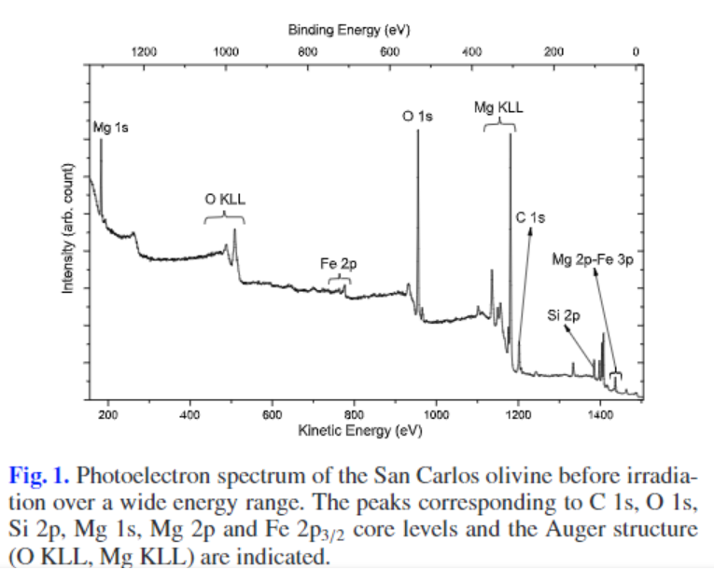
Correcting for surface charge
UW- Madison Geoscience 777
Need to have a way to correct the energy scale for any residual surface charge after neutralization.
Nature provides: virtually all surfaces exposed to the atmosphere will have a small amount of “adventitious” carbon (short chain C-C,C-H bonds).
Generally agreed to appear at ~284.8eV in XPS.
Shift = Observed C1s peak -284.8
Shift ALL spectra the same amount

Slide 23
Analysis Depth
UW- Madison Geoscience 777
Electrons in a solid can only travel a short distance before interacting with other electrons or atoms.
Most such interactions are “elastic” – energy is transferred from the electron.
Only electrons emitted within the first several atomic layers have a significant chance of escaping the surface with their original energy.
Most others will be absorbed, but some will be “scattered” and escape the surface, but with lower energy.
Electrons emitted near the surface can escape at any angle, but electrons from deeper layers need to be travelling nearly perpendicular.
Photoelectrons and Auger electrons are characterized by their energy – if they elastically scatter they are lost to the analysis

Slide 24
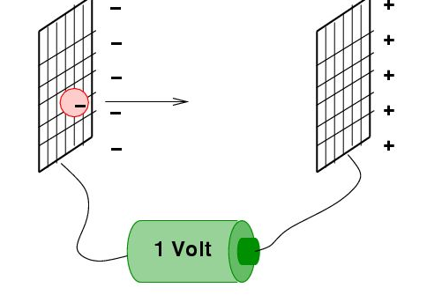
The convenient Electron Volt:
UW- Madison Geoscience 777
Unit of energy defined as the amount of work required to move a particle with a charge of 1e ‘uphill’ through a potential difference of 1 volt. Conversely it is equal to the kinetic energy gained by an electron when it is accelerated ‘downhill’ through potential difference of 1 volt. 1 eV x 1 Coulomb = 1 Joule
38 meV: average kinetic energy of a thermal air molecule at STP.
720 meV: the energy required to break a covalent bond in germanium
1.1 eV: the energy required to break a covalent bond in silicon
1.6 eV to 3.4 eV: the photon energy of visible light
0.1 eV to 10 eV: per bond energy of molecular bonds
13.6 eV: the energy required to ionize atomic hydrogen;
10-1100eV: all elements have some core level orbitals in this range
1486eV: Energy of the Aluminum K-alpha X-ray photon.
1 MeV (1.602×10−13 J): about twice the rest energy of an electron
200 MeV: the average energy released in nuclear fission of one U-235 atom
An electron column might have its source potential at -10kV – when an electron from this source reaches a ground potential, it will have 10keV of kinetic energy.

Slide 25
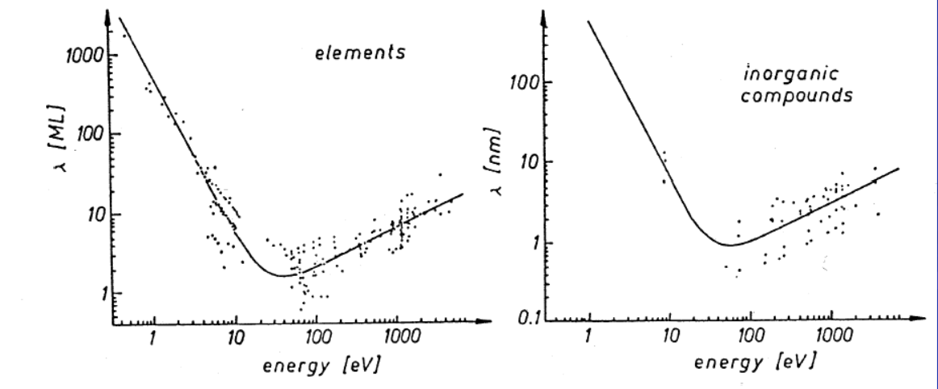
Analysis Depth
UW- Madison Geoscience 777
Inelastic Mean free path (λ)is ~1-5nm (10-50A) for typical XPS and AES measurements
Beer’s law: I = I₀ exp(z/ λ), For z= 3 λ, I/ I₀ = 0.05. 95% of signal comes from < 3 λ

Slide 26
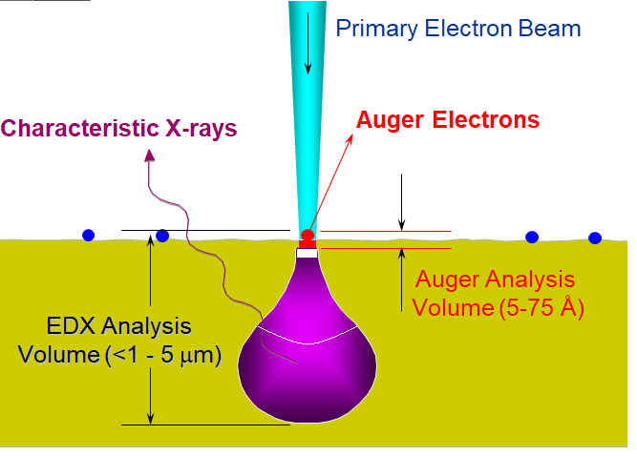
EDS vs. Auger
“Spot size” determined by incident beam. - With Field Emission Electron Source minimum lateral resolution <10 nm - (EDS with the same source: analysis area > 1um)
Analysis depth <10nm
Nano-volume analysis capabilities.
Note: Secondary and backscattered electrons will be detected along with Auger electrons.
Secondary Electrons
Backscattered Electrons
UW- Madison Geoscience 777

Slide 27
Instrumentation
UW- Madison Geoscience 777
Instrumental essential features:
Instrumental essential features:
Vacuum envelope (and pumping systems
Excitation source (XPS:X-rays, AES: Electrons)
Electron Energy Analyzer and detector
Additional features:
Charge neutralization sources (low energy electrons, ions)
Sputter ion guns (surface cleaning, depth profiling)
UHV Vacuum Envelope
Electron Energy
Analyzer & Detector
Excitation Source X-rays
Electrons
Electrons
Sample

Slide 28
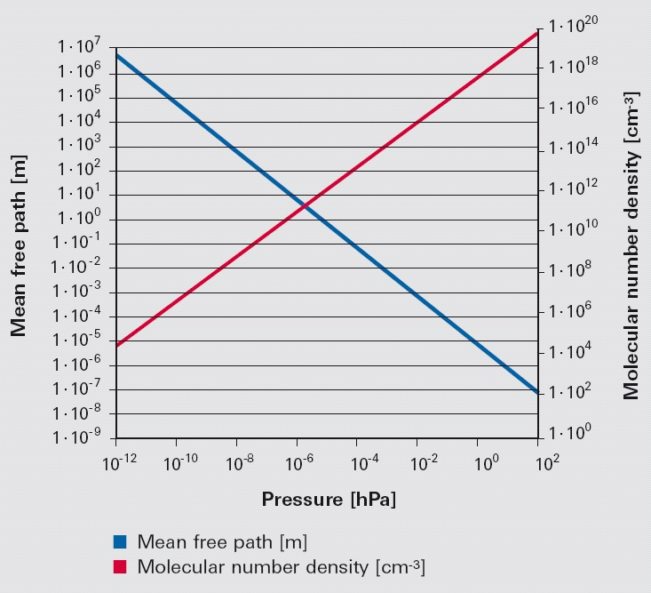

Vacuum requirements
UW- Madison Geoscience 777
For a gas, the mean free path (distance a particle can travel without a collision):
$I= \frac{kT}{\sqrt{2}π p d^{2}}$
p=pressure, d=Molecular diameter
Electrons scattered between the sample and detector reduce signal and increase background noise.
For practical analyses, I >> path length from sample to detector (~1-2m).
Pressure < 1e-4 Pa (~5e-7 torr)

Slide 29

Vacuum requirements
UW- Madison Geoscience 777
At a surface exposed to a gas, particles impact the surface at a rate proportional to pressure. A high percentage of those particles will “stick” to most clean surfaces.
Particle flux on a surface: $Γ=\frac{nv}{4}$
$n=v$ particle density. $v$ = average velocity
From ideal gas law: $Γ=\frac{P}{\sqrt{2πmkT}}$

Slide 30
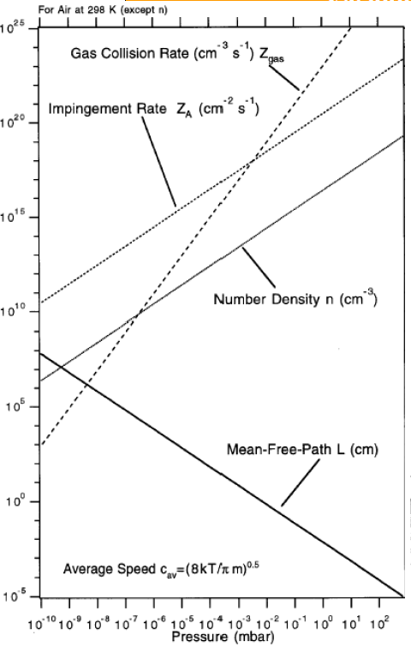

Vacuum requirements
UW- Madison Geoscience 777
Monolayer formation time is equal the number of sites on a surface divided by the impingement rate (flux) and the stiction coefficient (probability a particle remains on the surface)
$t_{c}=\frac{N_{s}}{SΓ}$, S = stiction coefficient =1
A typical surface may have 10¹⁵ sites/cm²
At 1 atm $t_{c}$ = 3ns,
at 0.1pa, $t_{c}$=3e⁻³ s
at 10⁻⁴ pa, $t_{c}$= 3s,
at 10⁻⁷ pa, $t_{c}$ = 3000s
Pressures < 1e-6 pa (UHV range) required to maintain surface cleanliness during analysis.

Slide 31
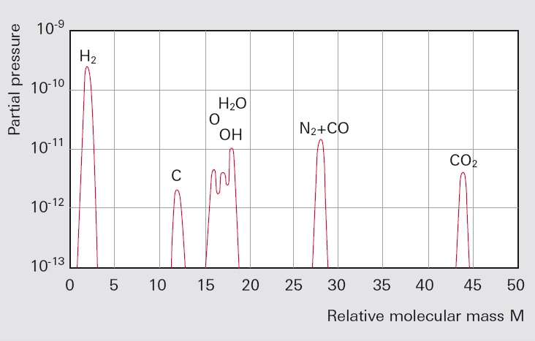
Vacuum requirements
UW- Madison Geoscience 777
Residual gas species in a vacuum chamber consist primarily of H, H₂0 (-> OH, O), CH⁴, N, CO and organic compounds
Most are likely to react with surfaces on contact, especially in the reducing environment created by energetic electrons
“stiction” coefficient ~1

Slide 32
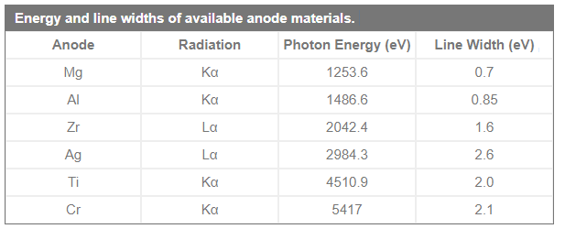
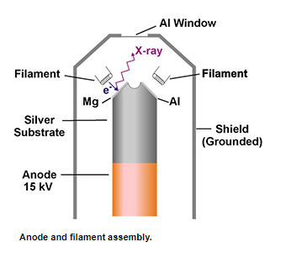
Instrumentation: X-ray Sources (XPS)
Characteristics of an X-ray source for XPS:
Approximately Monochromatic for narrow distribution of photo-electrons
Appropriate energy: 1-5keV
Low background electrons, x-rays, heat
“Standard” X-ray source
“Standard” Source
Electrons bombard metal surface with high energy (10-15keV)
X-rays produced by fluorescence flood sample
Typically multiple X-ray energies
Bright, simple, low cost
1/r² loss of intensity (must be close to sample)
Sample exposed to heat, electrons excited from window.
Satellite X-ray peaks.
UW- Madison Geoscience 777

Slide 33
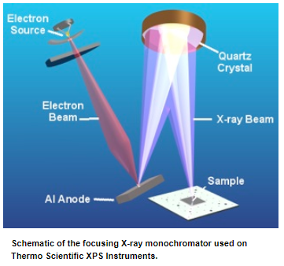
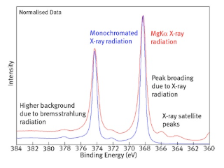
Instrumentation: X-ray Sources (XPS)
UW- Madison Geoscience 777
To overcome limitations of standard source, most instruments are now equipped with an X-ray Monochromator:
Aluminum K-alpha electron has wavelength ~ lattice separation in quartz
Quartz crystals can be used to diffract Al Kα X-rays through reasonable geometries.
By placing the quartz crystals on an appropriately curved substrate, X-rays can be micro focused onto sample surface ( <10um spot sizes). Brightness limit is the flux density of electrons the Anode can withstand.
Scanning electron beam on anode scans X-ray beam on sample
~0.2eV linewidths.
Low backgrounds, no exposure to heat/electrons from source
More complicated and expensive

Slide 34
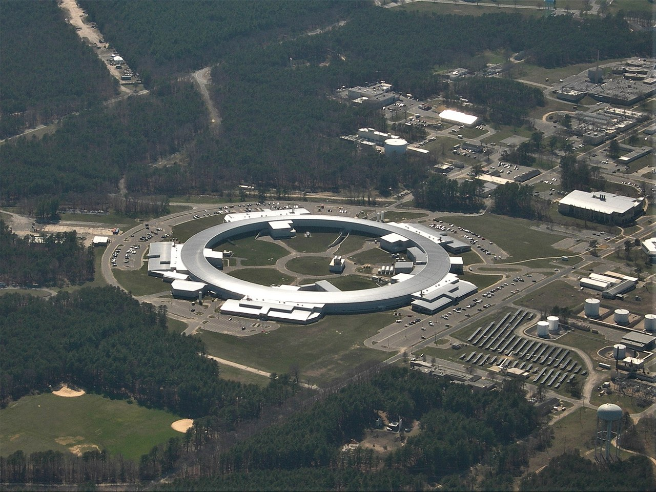
Instrumentation: X-ray Sources (XPS)
UW- Madison Geoscience 777
Synchrotron sources
Extremely high brightness
Micro focusing
Tunable X-rays
Not laboratory Scale

Slide 35
Instrumentation: AES sources
UW- Madison Geoscience 777
Focused Electron beam sources similar to those found in SEM & EPMA instruments
Tungsten filament
LaB6
Field Emission
But sources typically optimized for higher brightness rather than lateral resolution to provide better S/N for low intensity Auger Electron signals.
3nA – 1uA currents

Slide 36
Instrumentation: Electron Analyzers
UW- Madison Geoscience 777
Requirements for XPS:
Need to resolve peaks of a few 10ths of an eV → High energy resolution
Signals can be small → adjustable transmission
Unfocused sources → analysis are defined by analyzer
Emission angle contains information → Adjustable angular acceptance (high transmission vs. narrow acceptance)
Requirements for AES:
Auger signals have poor S/N→ High transmission
Auger signals tend to be wide → Modest energy resolution
Microscopically natural surfaces are often rough→ Insensitivity to sample geometry & shadowing
Analysis area always defined by beam, not analyzer.

Slide 37
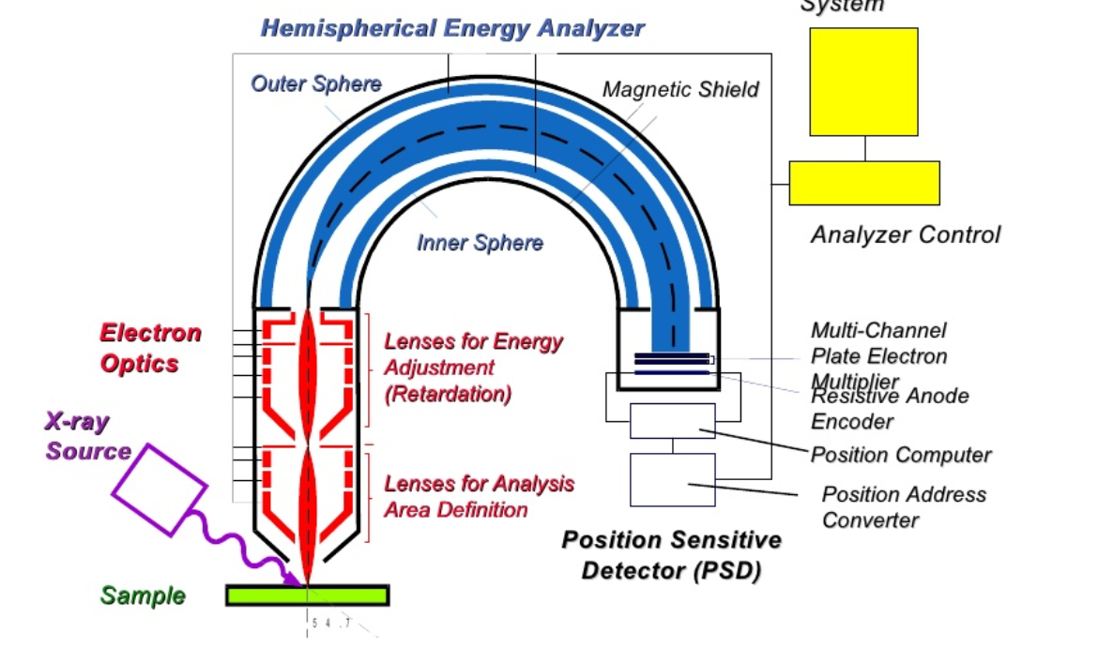
Instrumentation: XPS Electron Analyzers
UW- Madison Geoscience 777
Most XPS systems use a Hemispherical Capacitor Analyzer with input lenses:
Hemisphere can be adjusted for high transmission, or high energy resolution (0.1%/E)
Input lens provides high flexibility:
Adjustable area definition & angular acceptance
Adjustable energy retardation to optimize resolution vs. transmission
The retarding lens determines the kinetic energy of the electrons which enter the analyzer. “Scanning” over an energy range is performed by adjusting the retarding lens
The difference between the inner and outer spheres determines the “pass energy” window: Transmission vs. energy resolution.
Normally run in “Fixed Analyzer Transmission” mode: energy resolution is the same across the energy spectrum
To improve sensitivity a position sensitive detector oriented along the energy dispersion axis of the analyzer allows electrons of a range of energies to be counted in parallel, while retaining energy resolution.

Slide 38
Instrumentation: XPS Electron Analyzers
UW- Madison Geoscience 777
Small area XPS analysis area can be performed in two different ways.
“Zoom lens” only accepts electrons from a small area
Focused source: only excites a small area of the surface.

Slide 39
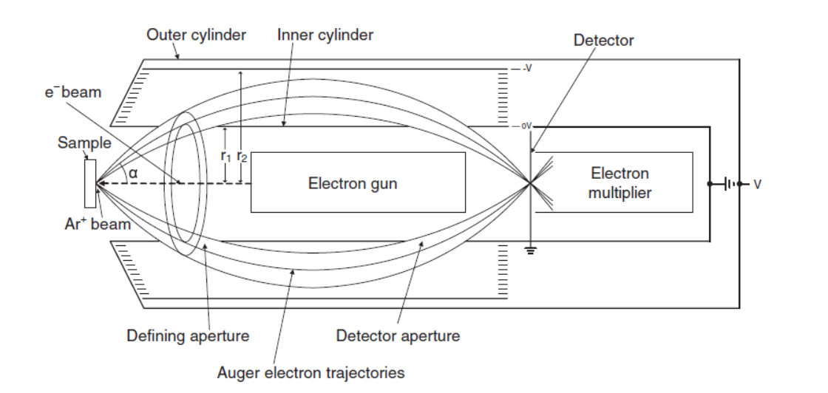
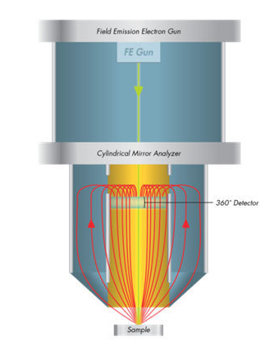
Instrumentation: AES Electron Analyzers
UW- Madison Geoscience 777
AES systems frequently use a Cylindrical Mirror Analyzer:
Very high transmission: wide acceptance angle, large energy pass window
Electrons can be emitted at any azimuthal angle and still enter analyzer
Because the electron trajectories don’t travel down the axis of the analyzer, an electron gun can be placed coaxially.
No shadowing, insensitive to surface roughness/geometry!
Usually run in “fixed retard ratio” (FRR) mode: Transmission increases and energy resolution decreases with increasing energy.
Poor energy resolution: 5% of E.

Slide 40
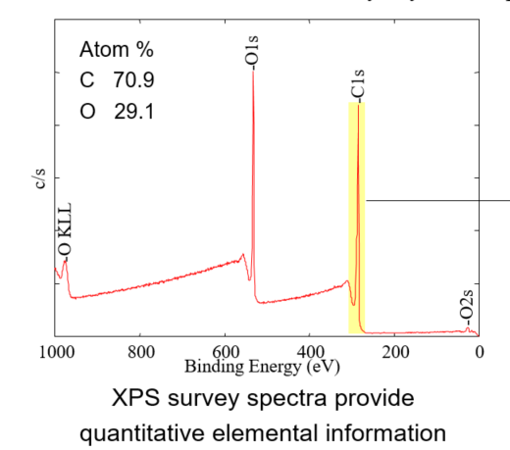
XPS Survey Spectra
“Survey” wide energy scan, high transmission, low resolution: polyethylene terephthalate example:
Note oxygen Auger line!
But why is the x-axis backwards!!
Note step in background at below each peak (in KE). These are electrons from the peak that are elastically scattered before leaving the sample: Average origin is deeper in the sample than the primary peaks.
BE = hv – KE
By measuring the area under the O1s and C1s peaks, we can quantify the elements
486 686 886 1086 1286 1486
Kinetic energy (ev)
UW- Madison Geoscience 777

Slide 41

XPS Elemental quantification
Intensity of a photoelectron peak (cps) is given by
For a given analyzer condition, all variables except n are constant. So we can assign an atomic sensitivity factor S:
The ratio of two elements:
The atomic fraction of constituent x:
Values of S are tabulated by instrument manufacturers (and embedded in instrument software).
UW- Madison Geoscience 777

Slide 42
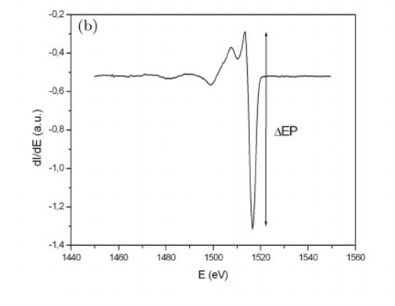
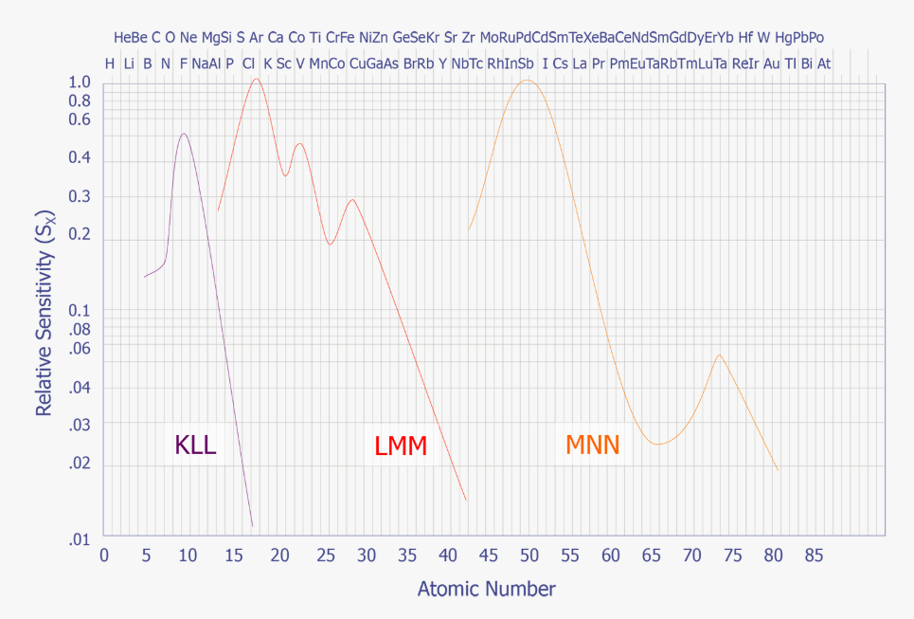
Auger Elemental quantification
Ditto what I just said about XPS
Auger peak intensities typically measured by peak-to-peak height of differentiated spectrum
Sensitivity factors are much more dependent on chemical state due to complexity of line shapes, variable backgrounds and differentiation
Sensitivity decreases for heavier elements.
UW- Madison Geoscience 777

Slide 43
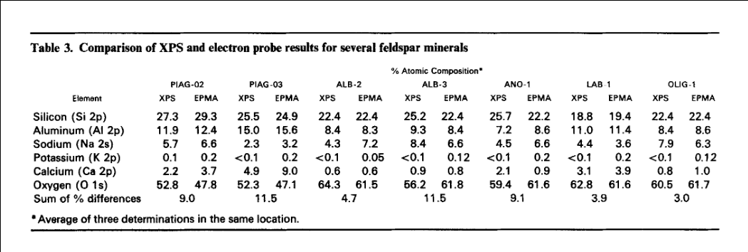
XPS Quantification
UW- Madison Geoscience 777
Elemental quantification comparable to EPMA, when materials are homogenous within the analysis volume.
Much smaller analysis volume!
Care must be taken in the presence of interface effects: contamination, oxidation, relaxation
https://www.researchgate.net/publication/230348878_Quantitative_XPS_Measurements_of_Some_Oxides_Sulphides_and_Complex_Minerals

Slide 44
XPS: Clues to the Chemistry
Initial state effects – “It was like that when I got here”
Chemical shift: Bonding environment of atom: increases or decreases actual binding energy of electron
Line widths: – width of line is dependent on chemical state
Lifetime of core vacancy (ΔEΔt = ħ)
Vibrational-rotational broadening
Final state effects – Outgoing electron excites additional discrete transition within atom or material.
Always reduces apparent binding energy
Asymmetry
Shake-up & Shake-off:
Plasmons
Virtually always related to “nearest-neighbor” interactions.
Powerful tool for
UW- Madison Geoscience 777

Slide 45
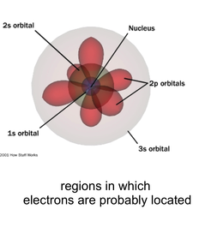
XPS: Initial state: Chemical shifts
UW- Madison Geoscience 777
Electron orbitals are ‘fuzzy’ probability distributions surrounding the nucleus.
To the extent that valence orbitals overlap core orbitals, they ‘screen’ the core orbital from the charge of the nucleus, reducing the binding energy of the core orbital electron.
As valence electrons form chemical bonds with other atoms, they are pulled into different orbitals that have more or less overlap with the core orbitals, resulting in a shift of the core orbital binding energy.
Oxidation: Cation core orbitals shift to lower binding energy, while the anion core orbitals shifts to higher binding energy

Slide 46
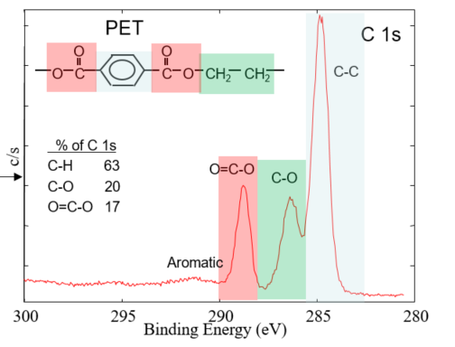
XPS: Initial state: Chemical shifts
UW- Madison Geoscience 777
High resolution scan of PET reveals structure of C1s peak, revealing chemical “shifts” due to different bonding environments within the PET molecule.
Quantification also works for when comparing chemical states.
No sensitivity corrections required- core level photoelectron cross sections are insensitive to bonding environment

Slide 47
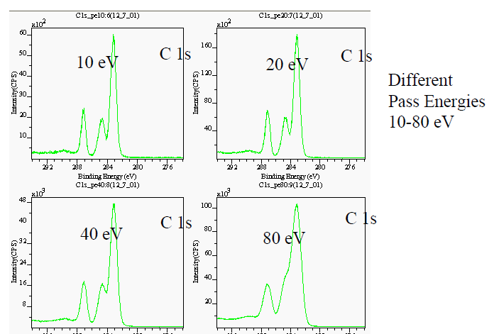
XPS: optimizing analyzer resolution
UW- Madison Geoscience 777
Decreasing analyzer resolution increases sensitivity.
Optimize instrument settings for best compromise depending on resolution and sensitivity required.

Slide 48
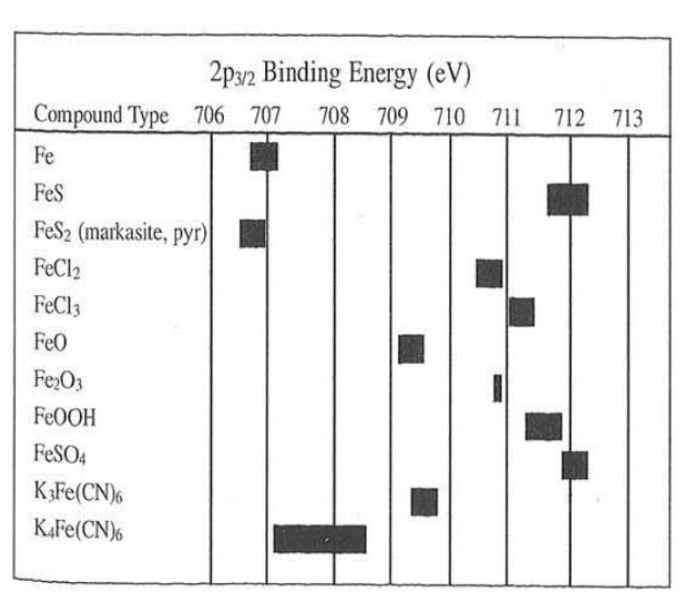
XPS: Clues to the chemistry
UW- Madison Geoscience 777
Magnitudes of chemical shifts for large numbers of compounds are found in the literature and tabulated in the “Handbook of X-ray Photoelectron Spectroscopy” and various on-line databases.

Slide 49
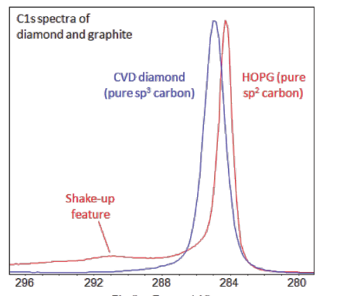
XPS Final State effects: Asymmetry
UW- Madison Geoscience 777
Conducting (and semiconducting) materials have a high density of energy states of the valence (conduction band) electrons with binding energies of zero to a few eV.
Photoelectrons have a high likelihood of interacting with these valence electrons and losing a little bit of energy
Results in an asymmetric tail to the low BE side of the peak.
Seen in virtually all conducting materials
Asymmetric Tail on C1s in Graphite

Slide 50
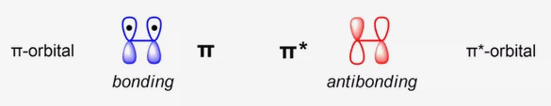
XPS Final state effects: Shake-up
UW- Madison Geoscience 777
Outgoing photo-electron may excite other discrete transitions.
Graphite is a conductor with covalent bonds shared around 6 membered rings of carbon
These “π” orbitals have two possible configurations: bonding and anti-bonding. The outgoing electron can ‘flip’ these from bonding to anti-bonding, giving up ~6eV in the process.
Characteristic of “benzene ring” structure in organic molecules
π → π* shake-up satellite

Slide 51
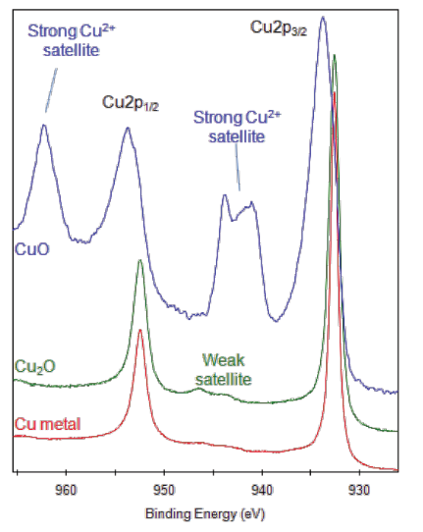
Final state Effects: Shake-up
UW- Madison Geoscience 777
In transition metals and rare-earths, strong shake-up lines typically occur in paramagnetic states (outer shell unpaired electrons)
Absence of shake-up indicates elemental or diamagnetic states
Often useful in determining chemical state where observed.

Slide 52
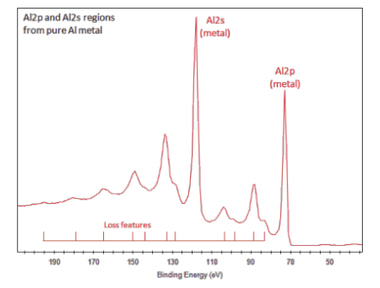

XPS Final state effects: Plasmons
UW- Madison Geoscience 777
A “Plasmon” is an oscillation mode of the free electron plasma found in the repeating lattice of a conducting material.
Because the plasma is ubiquitous there can be a high probability of interaction with an outgoing photoelectron → increasing the apparent binding energy.
The photoelectron can react more than once, resulting in a series of peaks to the higher energy side.
Conductors have two possible plasmon energies, 2d and 3d that differ in energy by $\sqrt{2}$
Most strongly observed in aluminum and silicon.
2x
3d plasmon sat.
3x
2d plasmon sat.

Slide 53
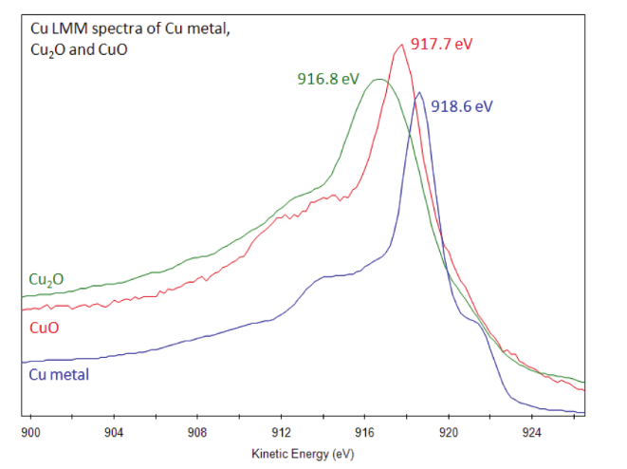
Auger Parameter
UW- Madison Geoscience 777
Cu₂O very weakly distinguished from Cu metal by either lineshift or shape, but in the KLL Auger peak the shift is larger than CuO!

Slide 54
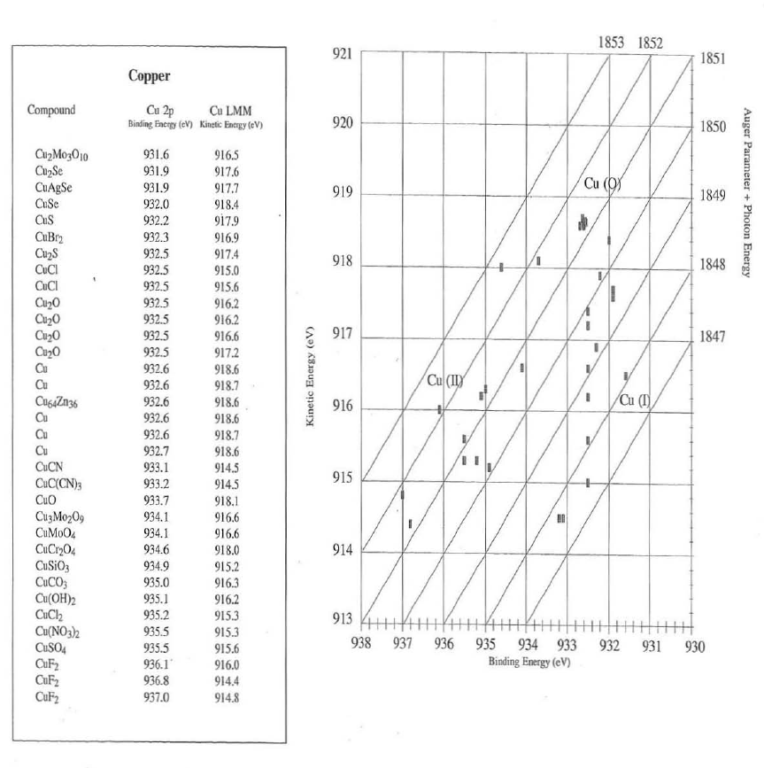

Auger parameter
UW- Madison Geoscience 777
Define the “Auger parameter” as the difference between an Auger and a photoelectron line.
$$α=KEA−KEP=BEP−BEA$$
Substituting: $KE=hv −BE$
$KEA+BEP=hv+$ $α$
This expression allows us to tabulate Auger parameter values that are independent of photon energy.

Slide 55
Auger parameter values – independent of photon energy:
UW- Madison Geoscience 777

Slide 56
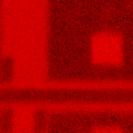
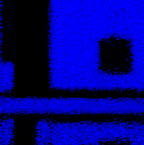
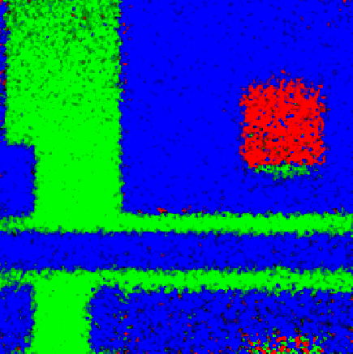
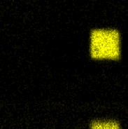

XPS Chemical State Imaging
Most recent generation of XPS instrument include the ability to scan the X-ray monochromator, or the acceptance area of the analyzer to create images
Provides imaging down to ~10um, but with low S/N
8 Min. Elemental Images
Extracted Si Basis Spectra
Si Chemical State Images
O 1s
N 1s
Si Oxide
Si Oxy-Nitride
Oxy-nitride
W_{x}Si_{y}O_{z}
Oxide
Silicide
W 4f
Si 2p
Silicide
UW- Madison Geoscience 777
500 µm FOV – 10 µm x-ray beam
108
106
104
102
100
98
96
500 µm FOV – 10 µm x-ray beam
Binding Energy (eV)
Colored dots indicate the locations basis spectra were extracted from
128 channel Si basis spectra used to create chemical state maps with LLS Fitting
Si oxide (green), Si oxy-nitride (blue), W silicate/silicide (red)

Slide 57

Chemistry by Auger
UW- Madison Geoscience 777
Auger electrons are also sensitive to initial and final state effects.
3-electron transitions create more complicated response to chemical states
Chemical state interpretation possible through peak shift and line shape analysis.
More reliant to comparison to reference materials.
Linear least squares fitting, Principal Component Analysis and Target Factor Analysis are some of the numerical techniques used to identify and quantify chemical state analysis of Auger spectra.

Slide 58
Auger Chemical State Analysis
High Energy Resolution Imaging of Semiconductor Chemical States
A
SEI
B
Si KLL Peak Area
C
Silicide
A
Composite Si KLL
Si KLL image with ROI areas
B
Silicide
LLS fitting from the basis spectra extracted from regions of interest used to create chemical state maps of Si with 50nm resolution
Intensity
Si Metal
D
Elemental Si
E
Si Oxynitride
F
Si Chemical States
1605
1615
1625
Kinetic Energy (eV)
Si KLL Basis Spectra
C
Si Oxynitride
Silicide
Intensity
Elemental Si
1604
1608
1612
1616
1620
1624
200 µm FOV SEI of a semiconductor bond pad
0.1% energy resolution data
Kinetic Energy (eV)
UW- Madison Geoscience 777

Slide 59

Auger Chemical State Analysis
High Energy and Spatial Resolution Imaging of Semiconductor Chemical States
A
SEI
B
Si KLL Peak Area
C
Silicide
Oxynitride (blue)
Elemental Si (green)
D
Elemental Si
E
Si Oxynitride
F
Si Chemical States
Silicide (red)
Auger Color Overlay 20kV 10nA 256x256 pixels
Green: Elemental Si Blue: Si Oxynitride Red: Silicide
200 µm FOV SEI of a semiconductor bond pad
0.1% energy resolution data
UW- Madison Geoscience 777

Slide 60


XPS Application: Alteration of olivine
Alteration of Olivine in a Carbonate rich aqueous environment at 70C
Initially surface shows:
Mg:Si:0 1:1:2 +1%Fe
Fe:2+
Si: silicate
C: Hydrocarbon
After reaction:
Si: SiO2
Mg:2+
O: SiO2
Carbonate
UW- Madison Geoscience 777

Slide 61




XPS Applications: Kinetics of radiation induced changes in olivine
Simulates radiation exposure in space
Reference spectra of Fe in Fe⁰, Fe²⁺ and Fe³⁺ states
Exposure to low fluences of He+ ions shifts the Fe²⁺ to Fe³⁺ at the surface
Exposure to higher fluences of He, or Ar ions reduces the Fe²⁺ to Fe⁰
Simultaneously the Mg/Si and O/Si ratios increase, indicating the formation of a surface layer Mg_{x}O_{y} surface layer
UW- Madison Geoscience 777

Slide 62
Auger Analysis of Thin Surface Defect
UW- Madison Geoscience 777
Neither Auger nor XPS require prior knowledge of the sample for analysis- commonly used forensic techniques for surface defects/contaminants
O
Si
Point 4
C
Cu
Cu
O
C
Point 3
c/s
Point 1 - Defect
Point 2 - Defect
Auger spectra (30 seconds each) show that the defect is Cu
200
400
600
800
1000
1200
1400
1600
1800
62
2000
Kinetic Energy (eV)

Slide 63

AES application: Ti/ TiB₂ / SiC Interface
(a) SEM image- SIC on the right, Ti on the left. TiB₂ intermediate layer
(b) Boron Auger map shows interaction of Boron containing coating with Ti matrix.
Composite image Carbon (green), Titanium (blue) and Boron (red) shows light blue phase. Spectrum indicates presence of TiC in this region
UW- Madison Geoscience 777

Slide 64



AES application: Pre-solar grains
UW- Madison Geoscience 777
Olivine Reference: No distortion to charging
Comparison of AES and EPMA on reference samples
Pyroxene and Olivine
Can be distinguished
https://journals.uair.arizona.edu/index.php/maps/article/viewFile/15752/15740

Slide 65
AES application: Pre-solar grains
UW- Madison Geoscience 777
SEM and Auger maps elemental maps
Pseudo-color overlay (upper right) identifies unique material phases
Magenta phase is identified as a forsteritic olivine (fosterite) phase ~300nm in size.
Smaller grains of similar composition are visible in the image.
https://journals.uair.arizona.edu/index.php/maps/article/viewFile/15752/15740

Slide 66
AES: In situ fracture analysis
In Situ fracture exposes a fresh surface of a material within the UHV analysis chamber.
Preserves the chemistry of the exposed fractured surface from reaction with air.
Common and powerful method for materials studies where grain boundary interfaces often determines bulk material properties
In this example the grain boundary can be 30+% P even though P is 0.05% of bulk composition
UW- Madison Geoscience 777
https://doi-org.ezproxy.library.wisc.edu/10.1002/sia.740100405

Slide 67
Going beyond the surface
UW- Madison Geoscience 777
Surface and near surface composition & chemistry often reflects bulk properties and can be extrapolated in many circumstances.
“Inert” materials show little difference between surface and bulk: polymers, oxides, crystalline materials (excluding metals). i.e surface composition can be extrapolated to bulk composition
Varying of surface sensitivity can deconvolve surface and bulk influences (angle resolved analysis)
Ion “sputtering” can be used to expose the sub-surface of a material (Depth profiling).
Sometimes the near surface volume is all the bulk you have: thin films in semiconductors, small grains

Slide 68

Going deeper, and shallower.
Changing the effective analysis depth :
XPS
“Angle Resolved” analysis – tilting sample or changing azimuthal acceptance angle. Grazing angles are more surface sensitive.
Comparing signals with different energies (hence escape depth)
Changing X-Ray excitation energy: Mg<Al<Cr<Zr or synchrotron sources
Ion Sputtering depth profiling
Auger:
“Angle Resolved” analysis
Comparing signals from different energy lines
Ion Sputtering depth profiling
K-Alpha
Photon Energies:
Mg 1253eV
Al 1486eV
Si 1739eV
Ti 4505eV
Cr 5405eV
Zr 15690eV
UW- Madison Geoscience 777

Slide 69




Angle Resolved Analysis
Beer’s law: I = I₀ exp(z/ λ).
Modified for “take off angle” θ: I = I₀ exp(z cos θ/λ),
Consider a thin layer A sitting on top of bulk material B:
Signal from A (integrated from depth d to 0:
Signal from B attenuated by passing through A:
Thickness d can be determined from the measured ratio of the signals from A and B.
Can be generalized to multiple layers.
Analysis at multiple angles can distinguish: uniform overlayers vs. islands vs. multiple layers vs. gradients.
UW- Madison Geoscience 777

Slide 70




XPS: Angle Resolved Examples
UW- Madison Geoscience 777

Slide 71


XPS X-ray energy profiling:
Cr K-alpha monochromator now available on some instruments (5420eV)
UW- Madison Geoscience 777

Slide 72


XPS X- ray energy profiling
Pyrite (FeS₂) fresh cleaved (001) surface in vacuum
Analysis with 1487eV X-ray shows surface contribution
Analysis with 260eV (synchrotron source) allows shows details of S shifts due to surface states
Consistent with cleavage only Fe-S bonds
UW- Madison Geoscience 777

Slide 73

XPS X- ray energy profiling
Pyrite (FeS₂) fresh cleaved (001) surface in vacuum
Analysis with 1487eV X-ray shows surface contribution
Analysis with 260eV (synchrotron source) allows
shows details of S shifts due to surface states
Consistent with cleavage only Fe-S bonds
UW- Madison Geoscience 777

Slide 74

Sputter Depth profiling
Energetic ion bombardment can be used to “sputter” the sample surface, removing material sequentially from the surface.
Alternates bombardment with spectroscopic analysis to build up a “profile” of the structure as it is “drilled down”
“Traditionally” done with a high energy 0.5-4keV Ar+ ion beam
Typical sputter rates: 0.5-2 nm/min
UW- Madison Geoscience 777

Slide 75
500 eV Ar⁺ Depth Profile of Low Emissivity Glass Coating
Sputter Depth profiling
Complex structures microns thick can be analyzed
100
~200 nm total film thickness
90
Ag
80
70
Ti
O
Ti
60
N
O
Zn
Zn
Ag
Atomic Concentration (%)
50
O
Zn
40
Si
30
Si
20
Al
Sn
Na
C
10
O
Sn
Sn
Al
Ca
Mg
0
0
50
100
150
200
250
300
Sputter Time (min)
UW- Madison Geoscience 777
Notes:
low-e coating-02.102.Low-e Glass+1_1.pro: low-e coating- 500eV Ar+ 750nA 3x3 mm with Zalar 1 min/cycle 9A/min vs. SiO2 2016 Aug 22 Al mono 50.0 W 200.0 µ 45.0° 140.00 eV PE 9A/min vs SiO2

Slide 76




Sputter Depth Profiling
UW- Madison Geoscience 777
Fe₇S₈ Sample proposed to have thin layer of surface oxide Fe(III)-Oxyhydroxide
Depth profile shows an intermediate Fe₂S₃ Layer ~5 monolayers thick

Slide 77
Sputter depth profiling has a problem!
UW- Madison Geoscience 777
Energetic ion bombardment tends to change the sample chemistry and stoichiometry
Reducing environment: will reduce most inorganic oxides significantly,
Preferential sputtering will change measured elemental ratios.

Slide 78
UW- Madison Geoscience 777
Sputter depth profiling:
10
Sputtering is particularly damaging to organic materials
PMMA and SiO2 at interface reduced
C 1s
Si 2p
80
60
Atomic Concentration (%)
0.25 kV Argon
Expected
Concentration
40
20
O 1s
20
0
0
50
100
150
200
Sputter Time (min)
Sputter Rate for SiO₂ ~ 0.3 nm/min
Sputter Rate for PMMA ~ 0.4 nm/min
Sample provided by Dr. Chris Szakal of NIST

Slide 79
UW- Madison Geoscience 777
Sputter depth profiling:
100
Recent developments in Ion gun technology:
C₆₀ (fullerines) ion gun
Gas Cluster Ar+ ion guns (2500AMU)
Both source bombard the surface with “big”, slow moving molecular structures.
Only interact with outer monolayer: preserve chemistry and stoichiometry of subsurface layers.
Effective on organic and inorganic materials
C₆₀ sputtering maintains expected chemical composition throughout the PMMA thin film
80
Si 2p
C 1s
60
Atomic Concentration (%)
10 kV C₆₀
40
20
O 1s
0
0
4
8
12
16
20
Sputter Time (min)
Sputter Rate: SiO₂ ~ 0.4 nm/min
Sputter Rate for PMMA ~ 8.3nm/min
Sample provided by Dr. Chris Szakal of NIST

Slide 80


GCIB Depth Profile of Organic LED Layers
Sputter Depth Profile of a Graded OLED Test Structure
100%
BPhen Gradient
TCTA Gradient
Si
10 kV Ar₂₅₀₀⁺ Sputtering
100
C 1s
0%
100 nm
80
N 1s (BPhen)
10X
N 1s (TCTA)
10X
Native Oxide
O 1s
N1s (TCTA)
N1s (BPhen)
60
Atomic Concentration (%)
Si 2p
40
TCTA
20
80
60
BPhen
0
40
0
50
100
150
20
Sputter Depth (nm)
0
410
405
400
395
Sample courtesy of Prof. Russell Holmes, U of MN
Binding Energy (eV)
UW- Madison Geoscience 777
Notes:
Tris(4-carbazoyl-9-yltriphenyl)amine
(TCTA) (Hole Transfer Material)
6.9 atomic % N 93.1 atomic % C
Higher N 1s Binding Energy
Bathophenanthroline
(BPhen) (Electron Transfer Material)
7.7 atomic % N 92.3 atomic % C
Lower N 1s Binding Energy

Slide 81


AES Charge Neutralization
UW- Madison Geoscience 777
Cluster Ar ion sources at low energies and doses can provide effective charge neutralization during Auger analysis on “moderate” insulators
Electrically isolated conductors
Thin non conducting layers over conductors
Materials with moderate electrical resistance

Slide 82
Going beyond the surface
UW- Madison Geoscience 777
Surface electron spectroscopies are:
“Easy”:
Insensitive to material characteristics (other than vacuum compatibility)
Require little or no material preparation (polishing, coating, etc)
Standards generally not required
Comprehensive:
Agnostic to composition (sensitive to nearly all elements)
Provide elemental and chemical identification
Quantitative for both

